Slide 1

Green Pace
Security Policy Presentation
Developer: Mitchell Lynds

Slide 2

OVERVIEW: DEFENSE IN DEPTH

Slide 3
THREATS MATRIX
 | Low Severity | Medium Severity | High Severity
Likely |  |  | STD-002-CPP STD-003-CPP STD-005-CPP STD-008-CPP
Probable | STD-007-CPP | STD-009-CPP | STD-004-CPP
Unlikely | STD-001-CPP STD-006-CPP |  | STD-010-CPP

Slide 4
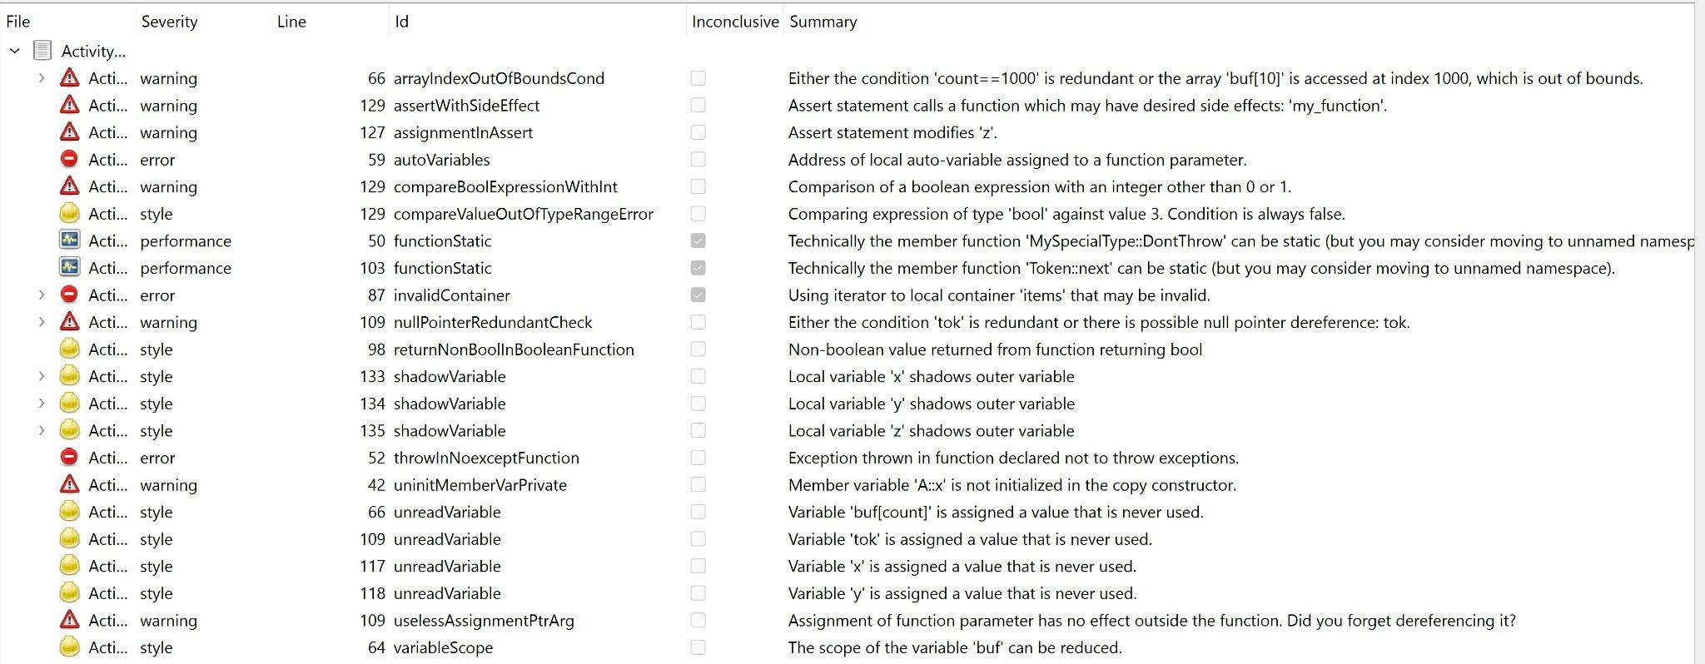
Detection Automation

Slide 5
10 PRINCIPLES
Validate Input Data
STD-002-CPP, STD-003-CPP, STD-004-CPP, STD-008-CPP, STD-010-CPP
Heed Compiler Warnings
STD-001-CPP, STD-005-CPP
Architect and Design for Security Policies
Keep it Simple
STD-001-CPP, STD-009-CPP
Default Deny
Adhere to the Principle of Least Privilege
Sanitize Data Sent to Other Systems
STD-007-CPP
Practice Defense in Depth
Use Effective Quality Assurance Techniques
STD-006-CPP
Adopt a Secure Coding Standard

Slide 6
CODING STANDARDS
STD-005-CPP: Do not access freed memory
STD-003-CPP: Guarantee that storage for strings has sufficient space for character data and the null terminator
STD-008-CPP: Exclude user input from format strings
STD-004-CPP: Prevent SQL injection
STD-002-CPP: Ensure that unsigned integer operations do not wrap
STD-009-CPP: Do not depend on the order of evaluation for side effects
STD-010-CPP: Range check element access
STD-007-CPP: Handle all exceptions
STD-001-CPP: Declare identifiers before using them
STD-006-CPP: Incorporate diagnostic tests using assertions

Slide 7
ENCRYPTION POLICIES
Encryption at Rest
Data storage encryption
Encryption in Flight
Data transmission encryption
Encryption in Use
Data use encryption

Slide 8
TRIPLE-A POLICIES
Authentication
Authorization
Accounting

Slide 9
Unit Testing
Tools for testing for the prevention of freed memory access in data structures

Slide 10
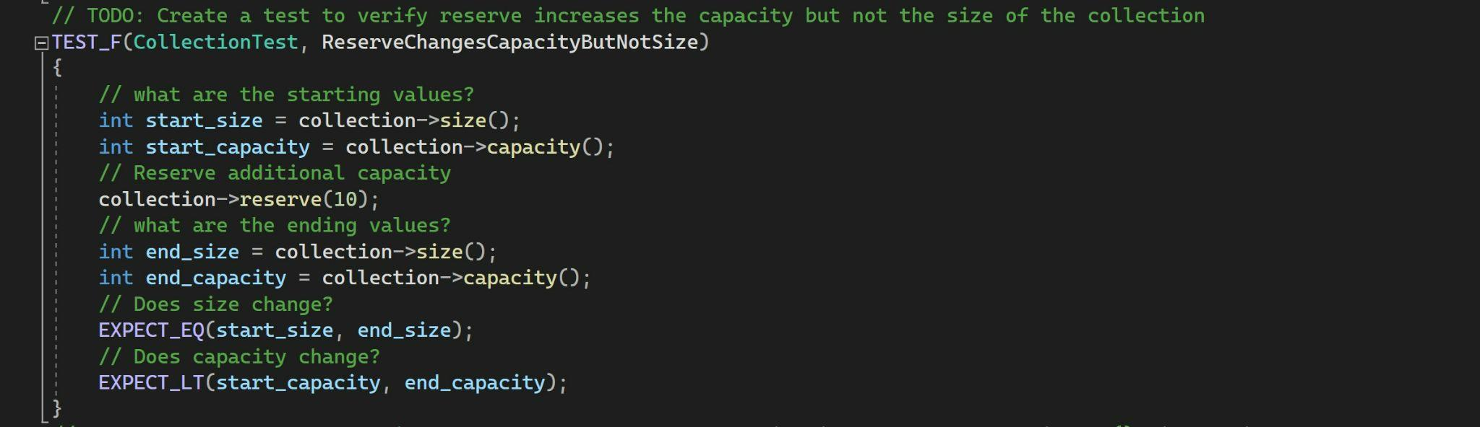
Does reserve() change capacity without changing size?

Slide 11
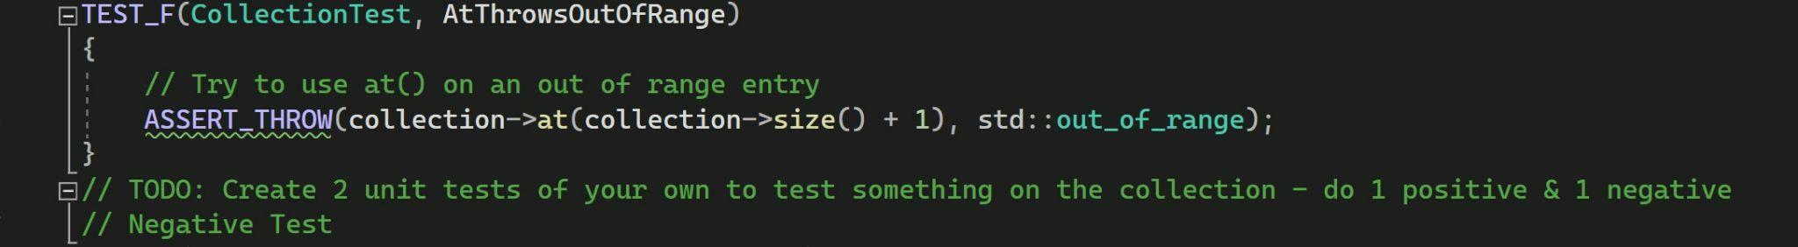
Does accessing an out of range index throw an exception?

Slide 12
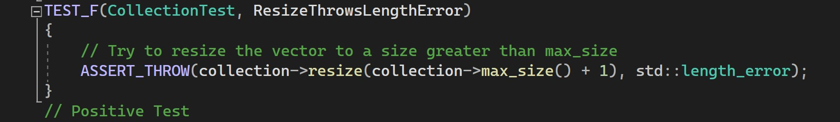
Does resizing to an invalid value throw an exception?

Slide 13
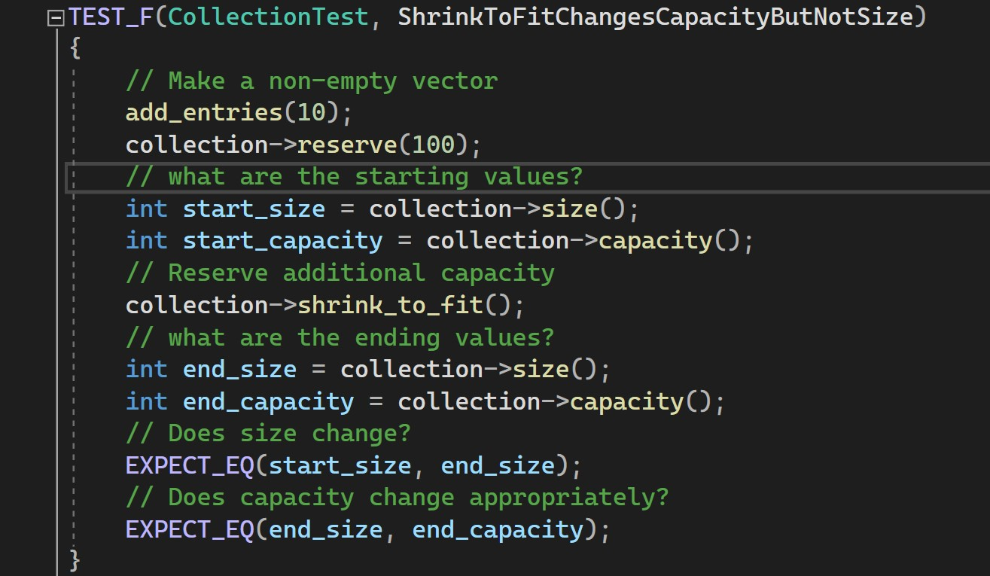
Does shrink_to_fit() change capacity but not size?

Slide 14

AUTOMATION SUMMARY

Slide 15
TOOLS
Automation in the DevSecOps Pipeline:
Design
Build
Verify and Test

Slide 16
RISKS AND BENEFITS
Act now:
-Risks
-Benefits
Wait to act:
-Risks
-Benefits

Slide 17
RECOMMENDATIONS
Existing violations:
-Address on a priority basis.

Slide 18
CONCLUSIONS
Current Gaps:
Do not use an additive operator on an iterator if the result would overflow
Guarantee that library functions do not overflow
Catch handlers should order their parameter types from most derived to least derived
Properly deallocate dynamically allocated resources
Detect and handle memory allocation errors
And More…
https://wiki.sei.cmu.edu/confluence/display/cplusplus/EE.+Risk+Assessments

Slide 19
References
Snavely, W. (2022, March 15). Ee. risk assessments. EE. Risk Assessments - SEI CERT C++ Coding Standard - Confluence. Retrieved April 23, 2023, from https://wiki.sei.cmu.edu/confluence/display/cplusplus/EE.+Risk+Assessments

